Slide 1

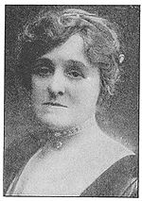
Edith Wharton

Slide 2
Edith Wharton
Born: in 1862
Occupation: She was a Pulitzer Prize-winning American novelist, short story writer and designer.
Died: in 1937
(1)
(2)

Slide 3
Her Works
In addition to her famous novels, Wharton wrote at least 85 short stories. She was also a regarded garden designer, interior designer and lifestyle taste-maker of her time. She wrote several influential design books including her first published work, The Decoration of Houses of 1897.
Novels
The Touchstone, 1900
The Valley of Decision, 1902
The Age of Innocence, 1920 (Pulitzer Prize winner)
Fast and Loose, 1938 (first novel, written in 1876-1877)
(3)
(4)

Slide 4
The style
In such works as The House of Mirth and The Age of Innocence she employed both humor and profound empathy to describe the lives of New York's upper-class and the vanishing of their world in the early years of the 20th century. In contrast, she used a harsher tone in her novel Ethan From to convey the atmosphere of lower-class rural Massachusetts.
Many of Wharton's novels are characterized by a subtle use of dramatic irony. Having grown up in upper-class pre-World War I society, Wharton became one of its most astute critics.
(5)
(6)

Slide 5
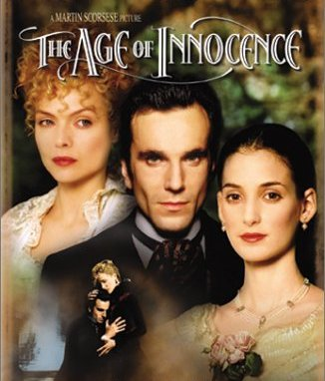

Slide 6
The Age of Innocence
The Age of Innocence (1920) won the 1921 Pulitzer Prize for literature, making her the first woman to win the award. She spoke flawless French as well as several other languages and many of her books were published in both French and English.
(1)

Slide 7
Introduction
Already a successful novelist in 1920 when she completed The Age of Innocence Edith Wharton anticipated best-selling status for her new novel. The Age of Innocence, set in late nineteenth-century New York society, did indeed become a best-seller and won the Pulitzer Prize the following year. Wharton was the first woman to receive this high literary honor. The novel is both nostalgic and satirical in its depiction of old New York, with its often-stifling conventions and manners and its insistence on propriety.
(3)

Slide 8
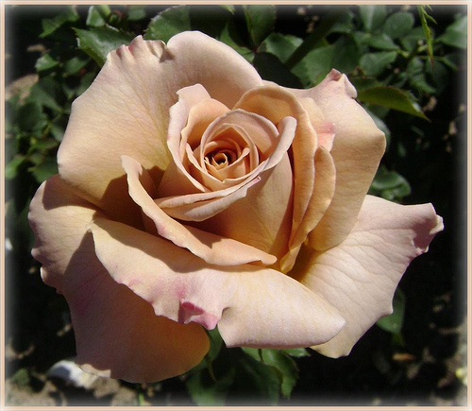
The Age of Innocence is regarded as a skilled portrait of the struggle between the individual and the community. It is also a work that explores the dangers and liberties of change as a society moves from a familiar, traditional culture to one that is less formal and affords its members greater freedom.
The novel's staying power is generally attributed to its presentation of such universal concerns as women's changing roles, the importance of family in a civilized society, and the universal conflict between passion and duty.
(6)

Slide 9
The plot
Meanwhile, Archer becomes increasingly disillusioned with his new fiancée, May. He begins to see her as the manufactured product of her class: polite, innocent, and utterly devoid of personal opinion and sense of self. The Countess Olenska soon announces her intention of divorcing her husband. While Archer supports her desire for freedom, he feels compelled to act on behalf of the Mingott family and persuade Ellen to remain married.
Newland Archer couldn't be more pleased with his recent engagement to the beautiful debutante May Welland. However, his world is thrown upside down by the sensational arrival of May's cousin, Countess Ellen Olenska. Recently returned to America after separating from her husband, a philandering Polish count, Countess Olenska shocks the staid New York aristocracy with her revealing clothes, carefree manners, and rumors of adultery. Because the Countess's family, headed by the powerful Mrs. Manson Mingott, have chosen to reintroduce her into good society, Archer and May feel it necessary to befriend her.
(8)
(7)

Slide 10
At a friend's cottage near Hudson, Archer realizes that he is in love with Ellen. He abruptly leaves the next day for Florida, where he is reunited with May and her parents, who are there on vacation.
There, he presses May to shorten their engagement. May becomes suspicious and asks him if his hurry to get married is prompted by the fear that he is marrying the wrong person. Archer reassures May that he is in love with her. Back in New York, Archer calls on Ellen, and Archer admits that he is in love with her. Just then, a telegram arrives from May, announcing that her parents have pushed forward the wedding date.
After their wedding and honeymoon in Europe, Archer and May settle down to married life in New York. Over time, Archer's memory of Ellen fades to a wistful image. But on vacation in Newport, he is reunited with her, and Ellen promises not to return to Europe as long as she and Newland do not act upon their love for each other. Back in New York, Archer learns that Count Olenski wants his wife to return to him and that Ellen has refused
(9)
(10)

Slide 11
Twenty-five years pass. In that time, the Archers have had three children and May has died from pneumonia. Now Archer's son convinces him to travel to France. There, they arrange to visit the Countess Olenska at her Paris apartment. However, at the last minute Archer sends his son alone to visit her, content instead to live with his memories of the past.
But suddenly, Ellen announces her intention to return to Europe. May throws a farewell party for Ellen, and after the guests leave, May announces to Archer that she is pregnant and that she told Ellen her news.
(11)
(12)

Slide 12

Mona AL-Shehri
Hend Al-Harthy
Hanaa AL-Turkey
Mashael AL-jedany
Marwa AL-Sheikh

